Slide 1




Microsoft Excel
Module 02
Did you know that Excel’s iconic grid of cells was inspired by the layout of a checkbook register? The idea was to create an easy way to organize and track
data in a grid-like structure

Slide 2


Class Objectives
1
Understand the basics of Excel – Including data entry, navigating the interface, and using basic formulas
2
Clean and transform data – Address missing data, remove duplicates, and format data for analysis
3
Create charts and visuals – Use Excel’s charting features to represent data visually
4
Aggregate data using Pivot Tables and Pivot Charts – Summarize data and present insights

Slide 3

Excel
A Game Changer for Data Analysis

Slide 4
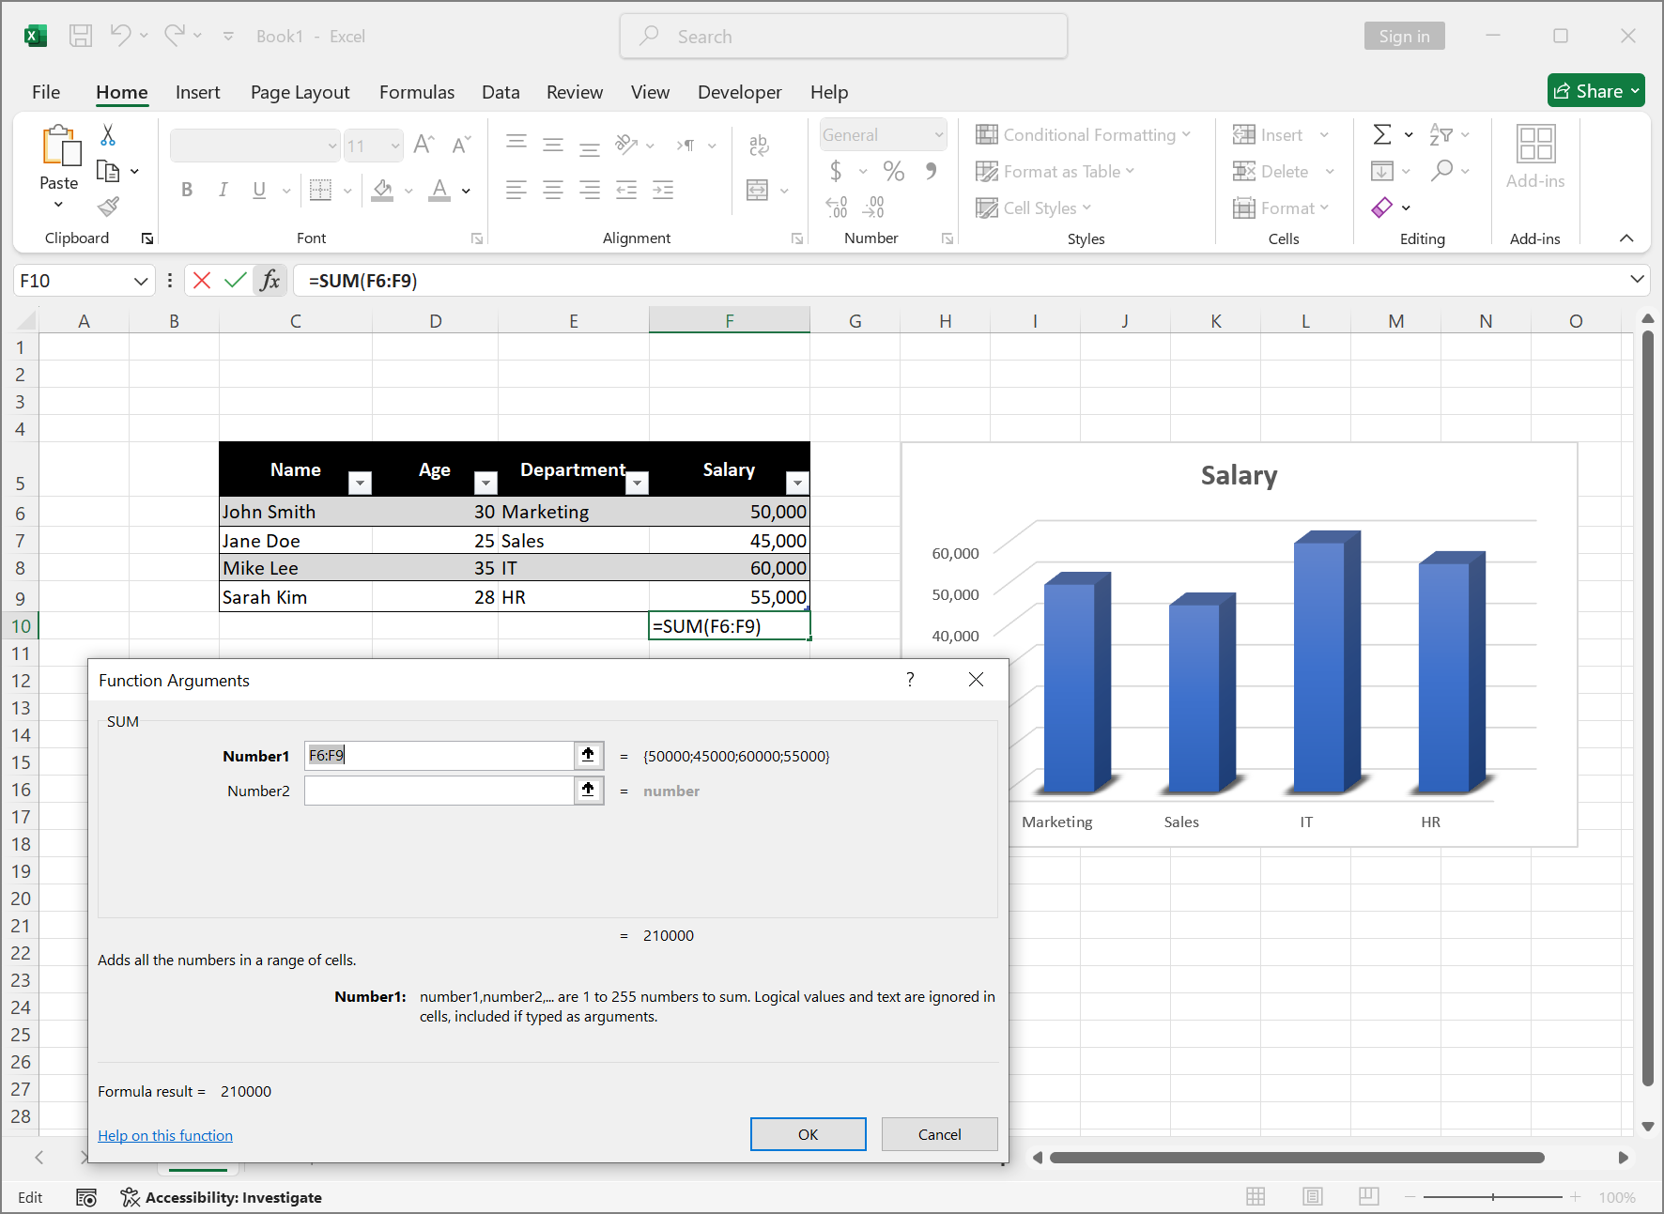
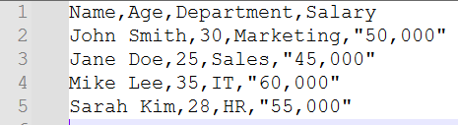
Spreadsheets and Excel
Spreadsheets are one of the most widely used tools for data analysis in the world

Slide 5
Spreadsheets and Excel
Spreadsheets are one of the most widely used tools for data analysis in the world
Excel, in particular, is the industry-standard tool used by analysts, business professionals, and data scientists for everything from simple calculations to complex data analysis

Slide 6
Why Spreadsheets Are So Essential in the Industry?
Data Organization: Spreadsheets help you store and organize large sets of data
Ease of Use: Simple drag-and-drop tools, formulas, and functions make it easy to manipulate data
Flexibility: You can customize spreadsheets to suit any kind of data or analysis, from sales reports to financial forecasts
Visualization: Turn complex data into easy-to-understand charts, graphs, and tables

Slide 7

Guided Demo
Super Store Sales Data

Slide 8
Super Store Sales
Excel Basics

Slide 9
Super Store Sales
Data Transformation

Slide 10
Data Transformation
Conditional formatting adds a layer of visual analysis, allowing you to quickly spot trends and outliers.
Color scales and icon sets make it easy to interpret large amounts of data quickly.
Use formatting sparingly. Too much can overwhelm the reader and make the data harder to interpret.
Ensure that custom rules don’t conflict with each other, creating confusion.

Slide 11
Super Store Sales
Data Aggregation
Pivot Tables & Pivot Charts

Slide 12
Data Aggregation – Pivot Tables
Pivot Tables allow us to dynamically summarize data and easily switch between different views.
You don’t need to restructure the data. Pivot Tables automatically aggregate and summarize it for you.

Slide 13
Data Aggregation – Pivot Charts
Pivot Charts help to visualize the insights that the Pivot Table is summarizing, making it easier to spot trends.
Slicers and timelines give users interactive control over the data displayed in Pivot Charts.
Charts should serve as a complement to your analysis, not as the main source of insights.
When working with charts, less is more. Avoid unnecessary complexity.
Tailor your chart design to your audience. Executive leaders may prefer simplified, high-level visuals, while analysts may need more detailed charts.

Slide 14
Super Store Sales
Analyzing Trends

Slide 15
Types of Trendlines
Linear Trendline:
Best for data that shows a consistent, steady increase or decrease.
Example: If our sales have been steadily increasing over time, a linear trendline is a good fit.
Moving Average:
Used to smooth out fluctuations and show trends more clearly.
Example: If our sales data is fluctuating month-to-month, a moving average will help smooth out those fluctuations and highlight the underlying trend.
Exponential Trendline:
Best for data that grows or declines at an increasing rate.
Example: An exponential trendline is ideal if sales are increasing at an accelerating rate, like in the case of a product launch or sudden market growth.

Slide 16
Challenge
Excel Playground
Leverage the Power of Excel to Uncover Insights from Data

Slide 17
Challenge: Excel Playground
Netflix Content Dataset
Field Name | Description | Data Type
show_id | A unique identifier for each content entry. | Text (String)
type | The type of content (e.g., Movie, TV Show). | Text
title | The title of the content. | Text
date_added | The date the content was added to Netflix. | Date (MM/DD/YYYY)
release_year | The year the content was originally released. | Integer
rating | The content's rating, indicating suitability for different audiences. | Text
duration | The duration of the content. For movies, this will be in minutes; for TV shows, it will indicate the number of seasons. | Text
Get this challenge’s files from Module 02 Live Lesson Challenge in Google Classroom

Slide 18
Challenge: Excel Playground
In this challenge you will:
Conduct a quick data clean-up
Apply basic calculations
Generate summaries using Pivot Tables and Pivot Charts
Respond to analytical questions
Get this challenge’s files from Module 02 Live Lesson Challenge in Google Classroom

Slide 19


Debrief
Let’s Review
Excel Playground

Slide 20
Questions?

